Slide 1
AB0LIFY
ABOLIFY

Slide 2
Deployment
Evaluation
Data Preparation
Modeling
Data Understanding
Business Understanding
Modeling

Slide 3
TABLE OF CONTENTS
TABLE OF CONTENTS
Deployment
Modeling
Data Understanding
Evaluation
Data Preparation
Business Understanding

Slide 4
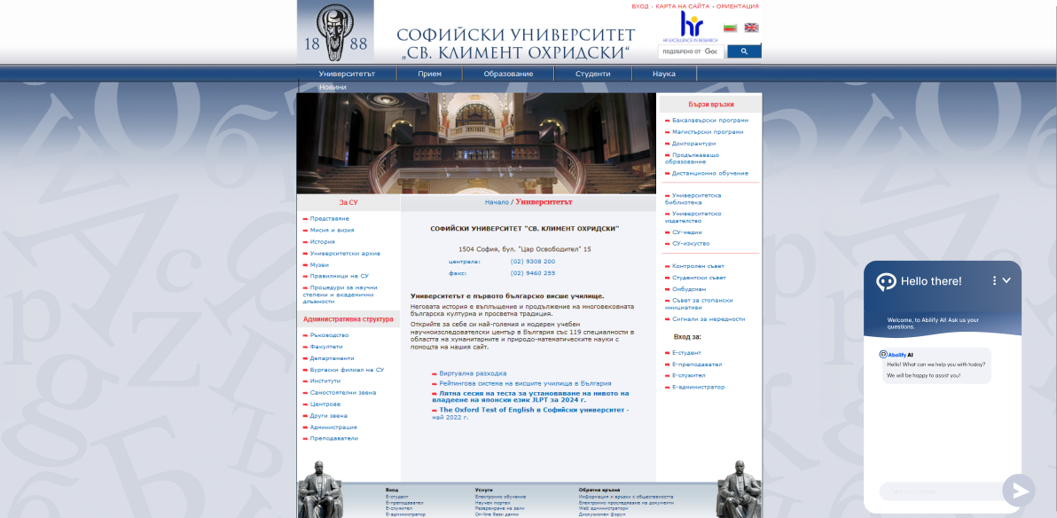

Business Understanding
Our project falls under the ‘Education’ category The solution we present aims to facilitate the orientation of a future student, after completing secondary education, towards a given specialty at the university where they intend to apply Our aim is to enhance accessibility to Sofia University's website
Business Understanding

Slide 5
Business Understanding
Business Understanding
Our project falls under the ‘Education’ category The solution we present aims to facilitate the orientation of a future student, after completing secondary education, towards a given specialty at the university where they intend to apply Our aim is to enhance accessibility to Sofia University's website

Slide 6
Data Understanding
Data Understanding
Confusion on university websites can impact students' future decisions Difficulty in finding information may lead to uninformed choices Implementing a chatbot system could offer clearer guidance, empowering students to make informed decisions.

Slide 7
Data Understanding
Data Understanding
Confusion on university websites can impact students' future decisions Difficulty in finding information may lead to uninformed choices Implementing a chatbot system could offer clearer guidance, empowering students to make informed decisions

Slide 8
Data Preparation
Data Preparation
To prepare the information, it initially webscraped, which is a way of collecting information from the university’s website It will be reviewed whether it is qualitative to know whether to modify it In the end, we will tokenize it

Slide 9
Data Preparation
Data Preparation
To prepare the information, it initially webscraped, which is a way of collecting information from the university’s website It will be reviewed whether it is qualitative to know whether to modify it In the end, we will tokenize it

Slide 10
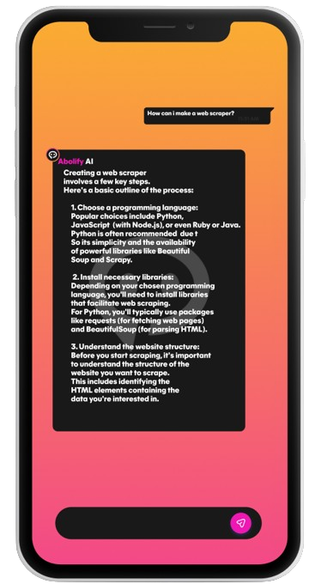
Modeling
Modeling
For the AI model we will make use of ChatGPT-4 Initially, context must be entered in the field where the AI will be contacted After entering the context, the question is entered; the next step is to set the return of the response

Slide 11
Modeling
Modeling
For the AI model we will make use of ChatGPT-4 Initially, context must be entered in the field where the AI will be contacted After entering the context, the question is entered; the next step is to set the return of the response

Slide 12
EVALUATION
evaluation
Our chatbot has demonstrated its ability to provide precise and reliable responses to inquiries related to Sofia University based on our thorough testing

Slide 13
EVALUATION
EVALUATION
Our chatbot has demonstrated its ability to provide precise and reliable responses to inquiries related to Sofia University based on our thorough testing

Slide 14



Deployment
Deployment
For the project we used Azure ML, Azure Web, ReactJs, and Python For the design we used Figma

Slide 15
Deployment
Deployment
For the project we used Azure ML, Azure Web, ReactJs, and Python For the design we used Figma

Slide 16
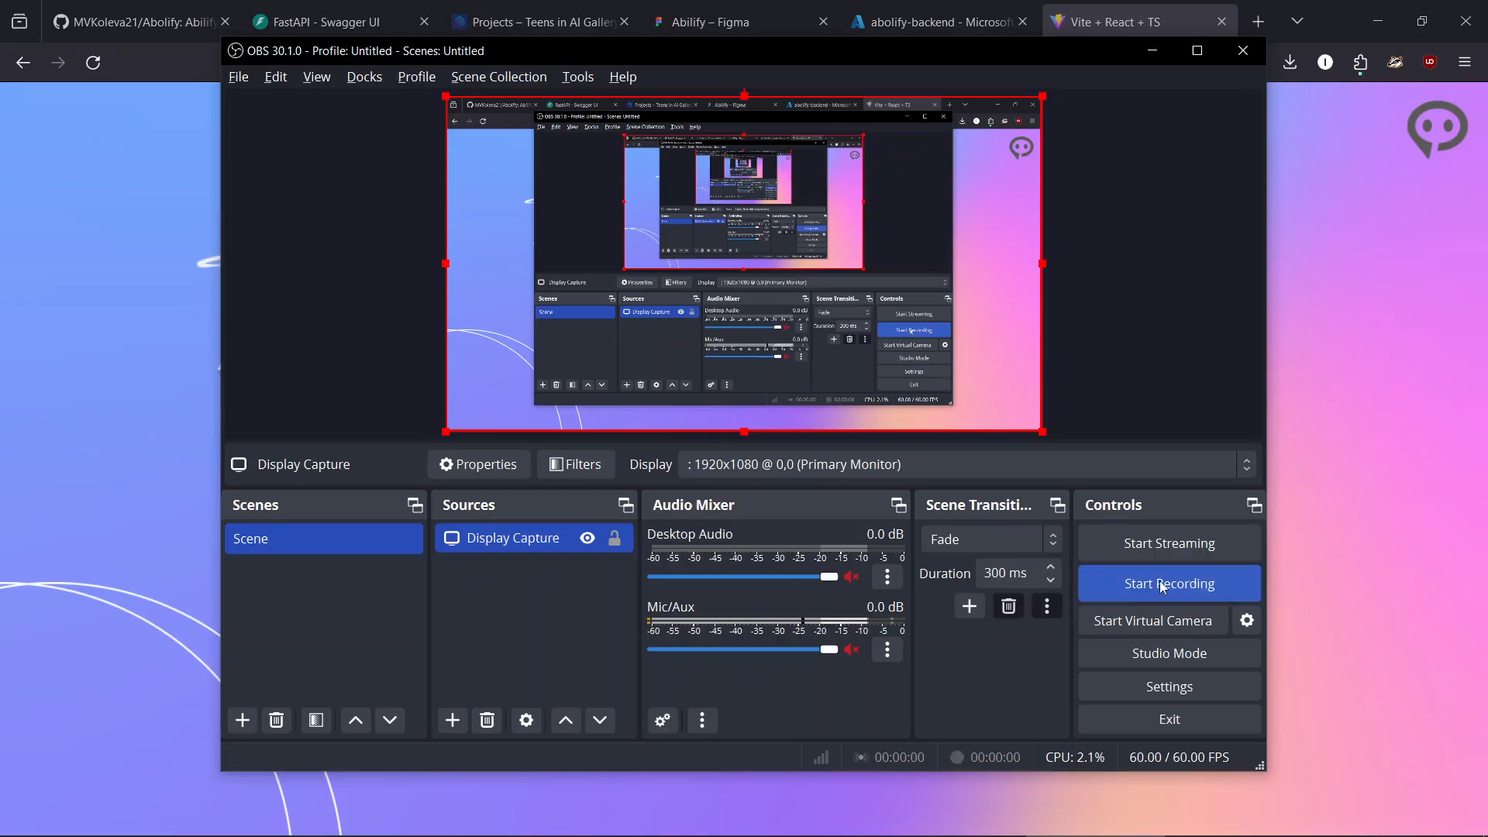

Slide 17
